Slide 1

ARTIFICIAL INTELLIGENCE
&
MACHINE LEARNING
SESSION NO : 23
Logistic Regression , Regularization (Ridge, Lasso)

Slide 2
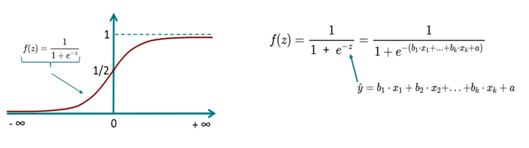
Logistic regression
Logistic Regression is a supervised machine learning algorithm used for classification problems.
Unlike linear regression which predicts continuous values it predicts the probability that an input belongs to a specific class.
It is used for binary classification where the output can be one of two possible categories such as Yes/No, True/False or 0/1.
It uses sigmoid function to convert inputs into a probability value between 0 and 1.

Slide 3
Logistic regression

Slide 4
Types of Logistic Regression
Binomial Logistic Regression:
This type is used when the dependent variable has only two possible categories. It is used for binary classification problems.
Examples: Yes/No, Pass/Fail or 0/1..
2. Multinomial Logistic Regression:
This is used when the dependent variable has three or more possible categories that are not ordered.
It extends the binary logistic regression to handle multiple classes.
Example: classifying animals into categories like "cat," "dog" or "sheep."
3. Ordinal Logistic Regression:
This type applies when the dependent variable has three or more categories with a natural order or ranking.
It takes the order of the categories into account when modeling.
Examples: ratings like "low," "medium" and "high."

Slide 5
Assumptions of Logistic Regression
Independence of observations: Each observation is assumed to be independent, with no correlation or dependence across samples.
Binary outcome requirement: Logistic regression assumes a binary dependent variable. When the outcome involves more than two categories, extensions such as the Softmax function are employed.
Linearity in the logit: A linear relationship is assumed between the independent variables and the log odds of the dependent variable, indicating that predictors exert a linear effect on the logit.
Absence of influential outliers: Extreme outliers should be avoided, as they can bias coefficient estimates.
Adequate sample size: A sufficiently large dataset is required to ensure precise, reliable, and stable parameter estimation.

Slide 6
Understanding Sigmoid Function
Sigmoid function in logistic regression:
The sigmoid function plays a key role in logistic regression by transforming the model’s raw output into a probability value between 0 and 1.
How it works:
This function accepts any real-valued number and maps it within the range of 0 to 1, producing an "S"-shaped curve known as the sigmoid or logistic curve. Since probability must always lie between 0 and 1, the sigmoid function is ideally suited for this task.
Threshold-based classification:
In logistic regression, a threshold (commonly set at 0.5) is applied to assign class labels:
If the sigmoid output is greater than or equal to the threshold, the input is classified as Class 1.
If it is below the threshold, the input is classified as Class 0.
This mechanism allows continuous outputs to be converted into meaningful categorical predictions.

Slide 7
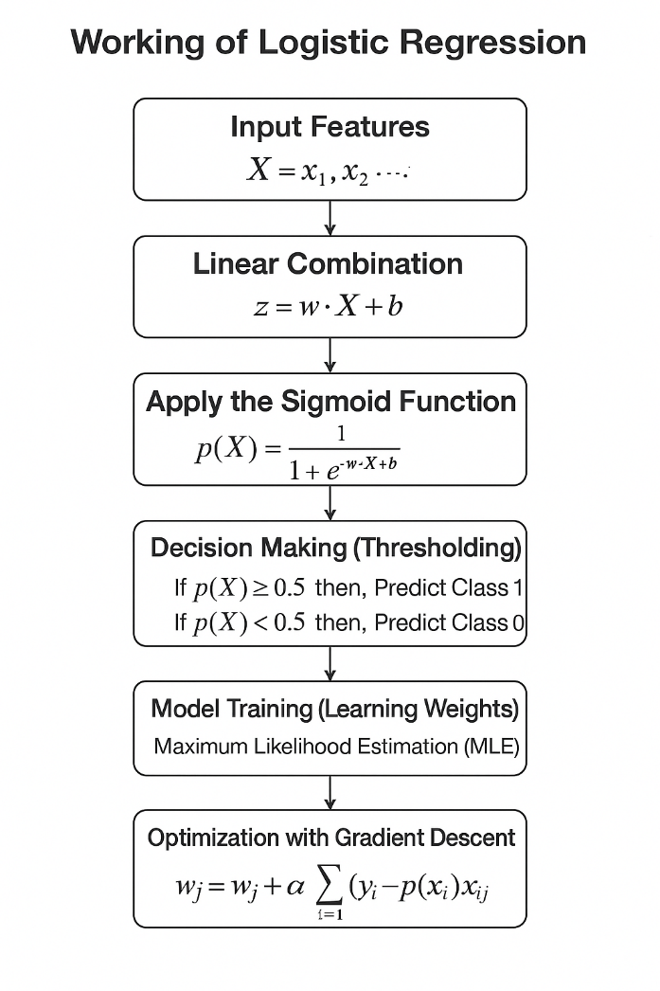

Slide 8
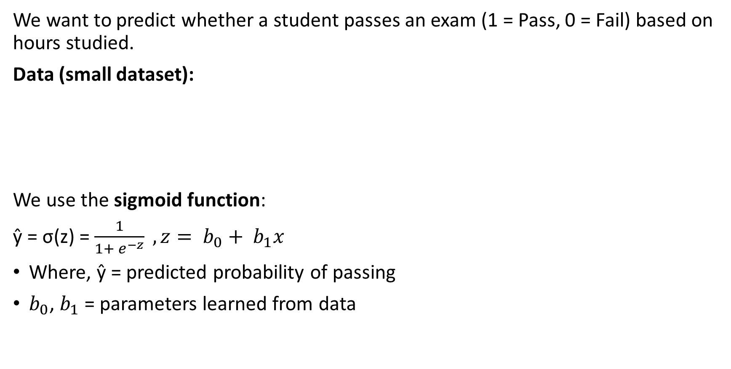
Example of Logistic Regression
We want to predict whether a student passes an exam (1 = Pass, 0 = Fail) based on hours studied.
Data (small dataset):
We use the sigmoid function:
ŷ = σ(z) = $\frac{1}{1+ e^{−z}} , z= b_{0}+ b_{1}x$
Where, ŷ = predicted probability of passing
$b_{0}$, $b_{1}$​ = parameters learned from data
Hours studied (x) | Pass/Fail (y)
1 | 0
2 | 0
3 | 0
4 | 1
5 | 1

Slide 9
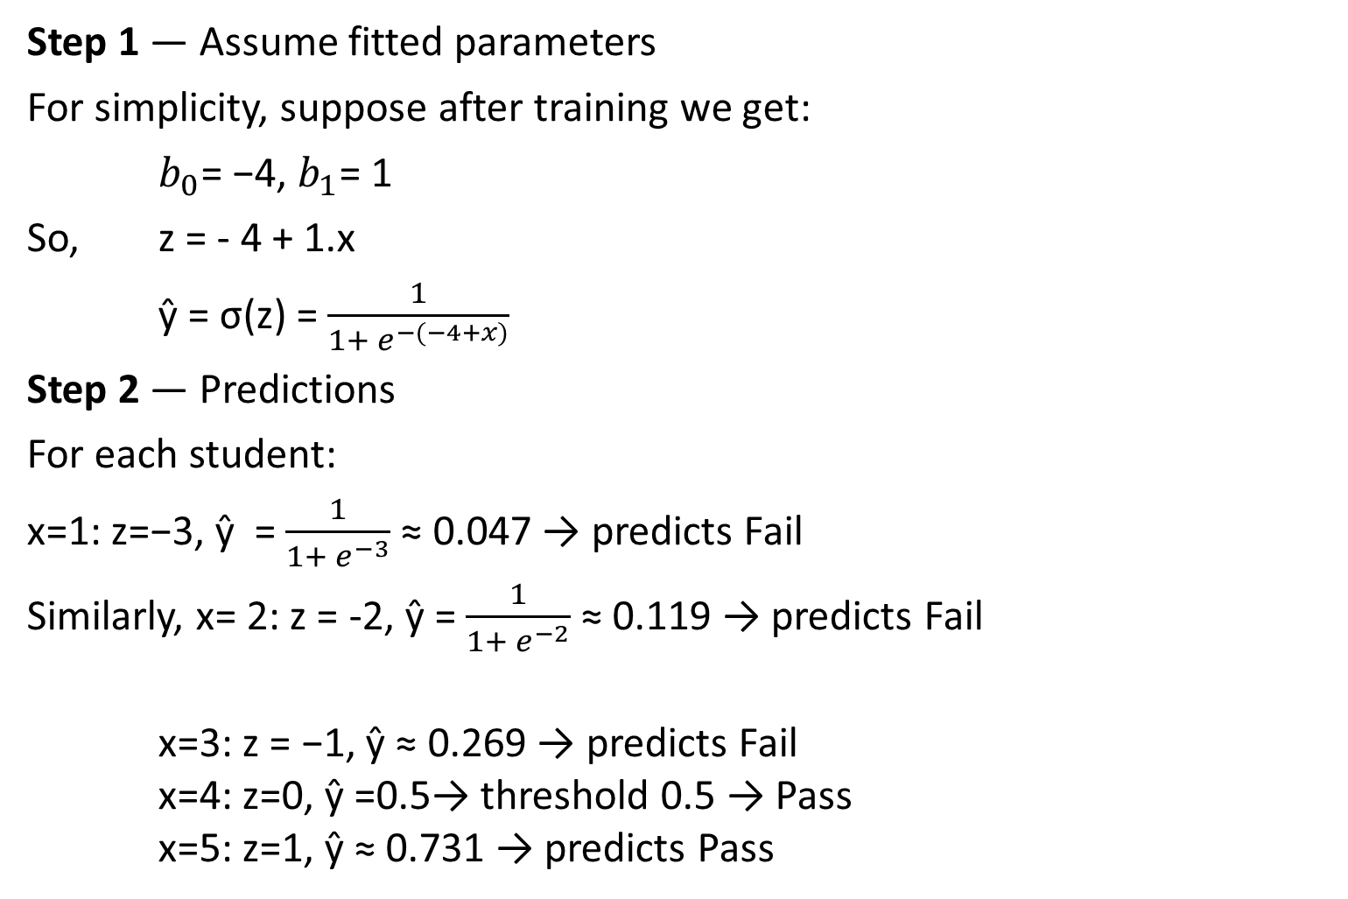
Example of Logistic Regression
Step 1 — Assume fitted parameters
For simplicity, suppose after training we get:
$b_{0}$= −4, $b_{1}$= 1
So, z = - 4 + 1.x
ŷ = σ(z) = $\frac{1}{1+ e^{−(−4+x)}}$
Step 2 — Predictions
For each student:
x=1: z=−3, ŷ = $\frac{1}{1+ e^{−3}}$≈ 0.047 → predicts Fail
Similarly, x= 2: z = -2, ŷ = $\frac{1}{1+ e^{−2}}$≈ 0.119 → predicts Fail
x=3: z = −1, ŷ ≈ 0.269 → predicts Fail
x=4: z=0, ŷ =0.5→ threshold 0.5 → Pass
x=5: z=1, ŷ ≈ 0.731 → predicts Pass

Slide 10
Example of Logistic Regression
Step 3 — Decision boundary
If we use 0.5 as the threshold, the decision rule is:
ŷ ≥ 0.5 ⇒ Pass, ŷ ​<0.5 ⇒ Fail
Boundary happens when:
− 4 + x = 0 ⇒ x = 4
So students who study ≥ 4 hours are predicted to Pass.

Slide 11

Regularization in logistic regression
Regularization in logistic regression is a technique used to prevent overfitting, especially when the model has many features or limited training data.
It does this by penalizing large coefficients in the model.
In logistic regression, the model predicts the probability that a given input belongs to a particular class:
If some feature weights become too large, the model might fit the training data too closely and fail to generalize to new data (overfitting).
Types of regularization are LASSO Regression and Ridge Regression

Slide 12
Benefits of Regularization
Prevents Overfitting: Regularization helps models focus on underlying patterns instead of memorizing noise in the training data.
Improves Interpretability: L₁ (Lasso) regularization simplifies models by reducing less important feature coefficients to zero.
Enhances Performance: Prevents excessive weighting of outliers or irrelevant features helps in improving overall model accuracy.
Stabilizes Models: Reduces sensitivity to minor data changes which ensures consistency across different data subsets.
Prevents Complexity: Keeps model from becoming too complex which is important for limited or noisy data.
Handles Multicollinearity: Reduces the magnitudes of correlated coefficients helps in improving model stability.
Allows Fine-Tuning: Hyperparameters like alpha and lambda control regularization strength helps in balancing bias and variance.

Slide 13
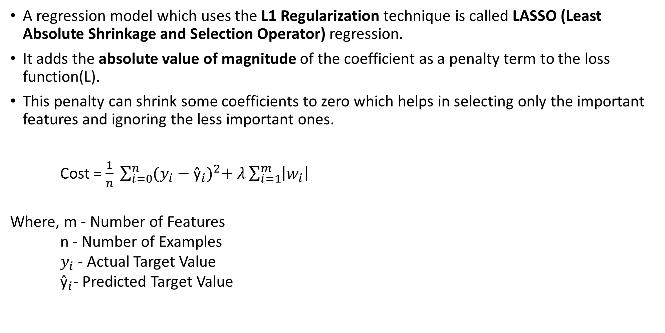
Lasso Regression
A regression model which uses the L1 Regularization technique is called LASSO (Least Absolute Shrinkage and Selection Operator) regression.
It adds the absolute value of magnitude of the coefficient as a penalty term to the loss function(L).
This penalty can shrink some coefficients to zero which helps in selecting only the important features and ignoring the less important ones.
Cost = $\frac{1}{n} \sum_{i=0}^{n}{{(y_{i}−{\text{ŷ}}_{i})}^{2}+ λ\sum_{i=1}^{m}{\left|w_{i}\right|}}$
Where, m - Number of Features
n - Number of Examples
$y_{i}$- Actual Target Value
${\text{ŷ}}_{i}$- Predicted Target Value

Slide 14
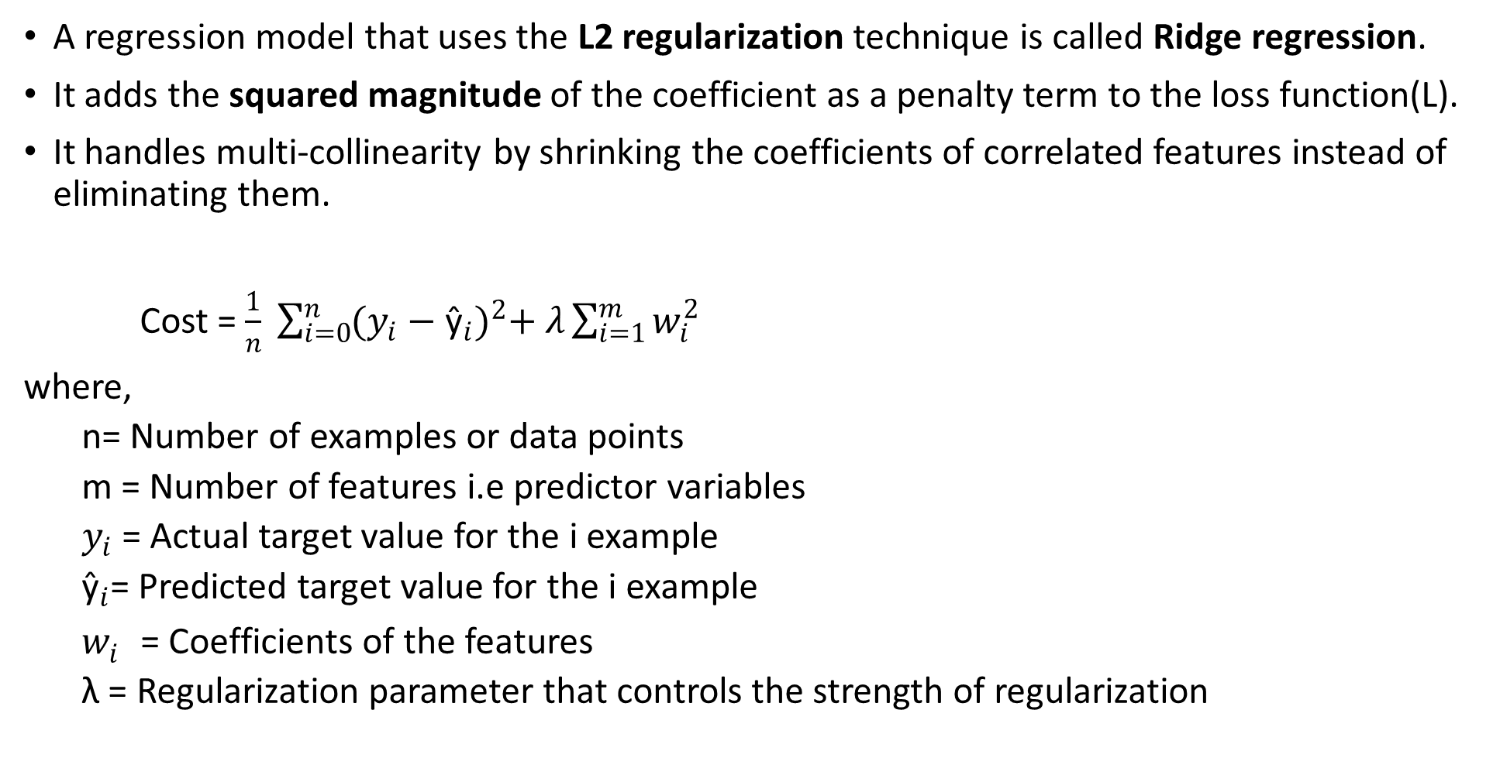
Ridge Regression
A regression model that uses the L2 regularization technique is called Ridge regression.
It adds the squared magnitude of the coefficient as a penalty term to the loss function(L).
It handles multi-collinearity by shrinking the coefficients of correlated features instead of eliminating them.
Cost = $\frac{1}{n} \sum_{i=0}^{n}{{(y_{i}−{\text{ŷ}}_{i})}^{2}+ λ\sum_{i=1}^{m}{w_{i}^{2}}}$
where,
  n= Number of examples or data points
  m = Number of features i.e predictor variables
  $y_{i}$​ = Actual target value for the i example
  ${\text{ŷ}}_{i}$= Predicted target value for the i example
  $w_{i}^{}$= Coefficients of the features
  λ = Regularization parameter that controls the strength of regularization

Slide 15
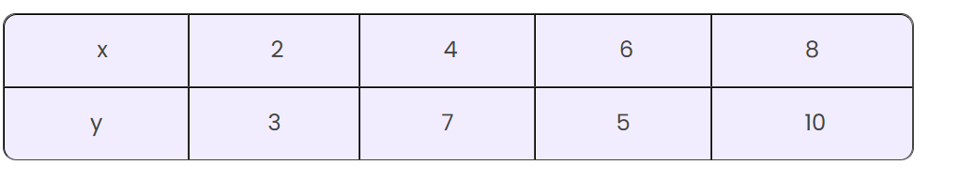

Slide 16

THANK YOU

